Slide 1
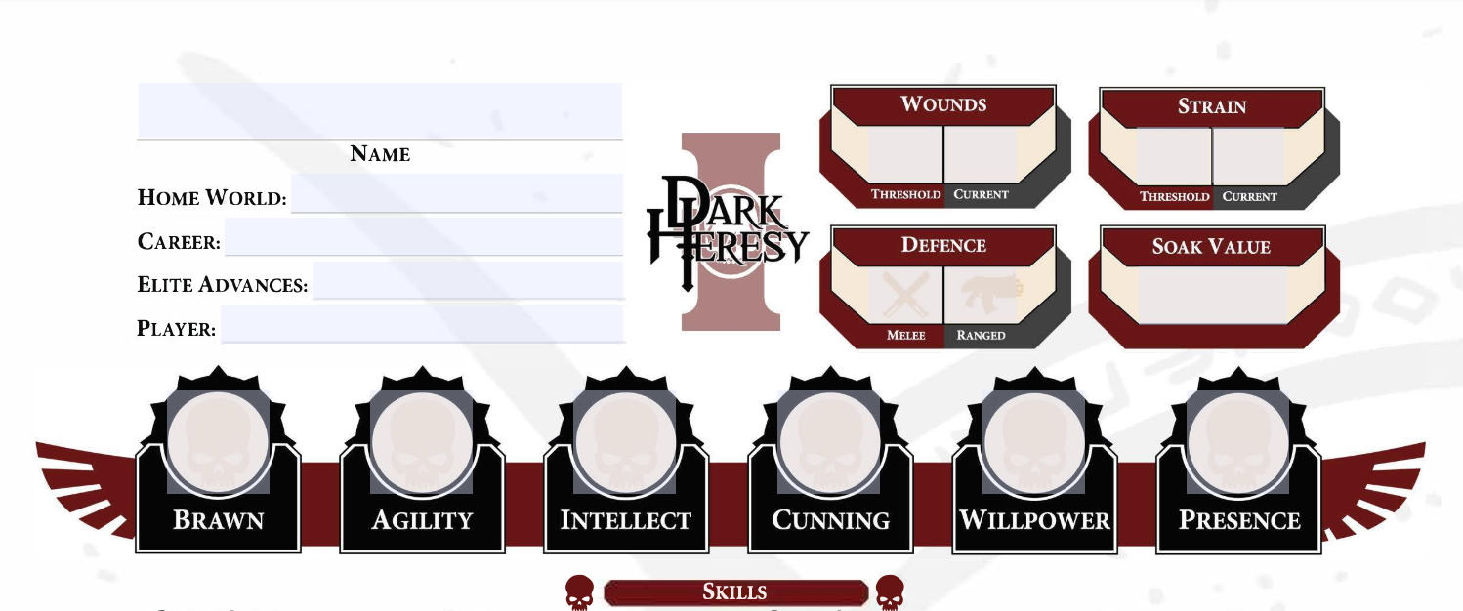
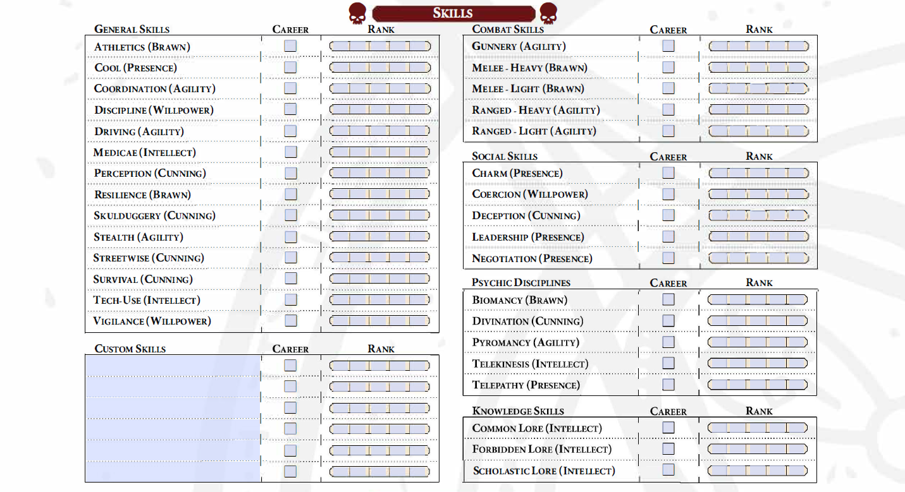
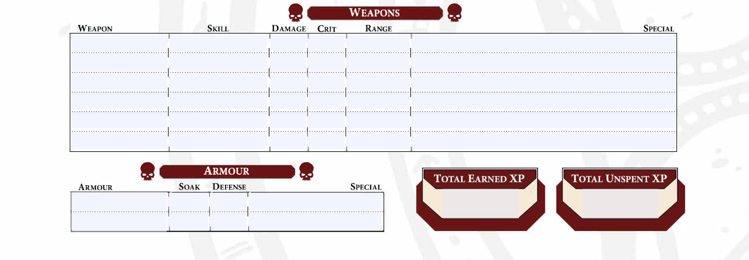
Gerhart Varkuul - Book - Notes
21
2
17
0
Feudal World
Crusader
N/A
6+1
6
13
Zach
6
2
2
2
3
2
Power Sword
Melee (Light)
+6
2
Engaged
Breach 2, Defensive 1, Destructive, Sunder
Power Shield
Melee (Light)
+3
4
Engaged
Breach 1, Defensive 3, Deflection 3, Inaccurate 1, Knockdown
Xenophase Blade
Melee (Light)
+6
2
Engaged
Phase
Heavy Power Armor
5
2
Enc 12, HP 5, Rar 12
450
15

Slide 2
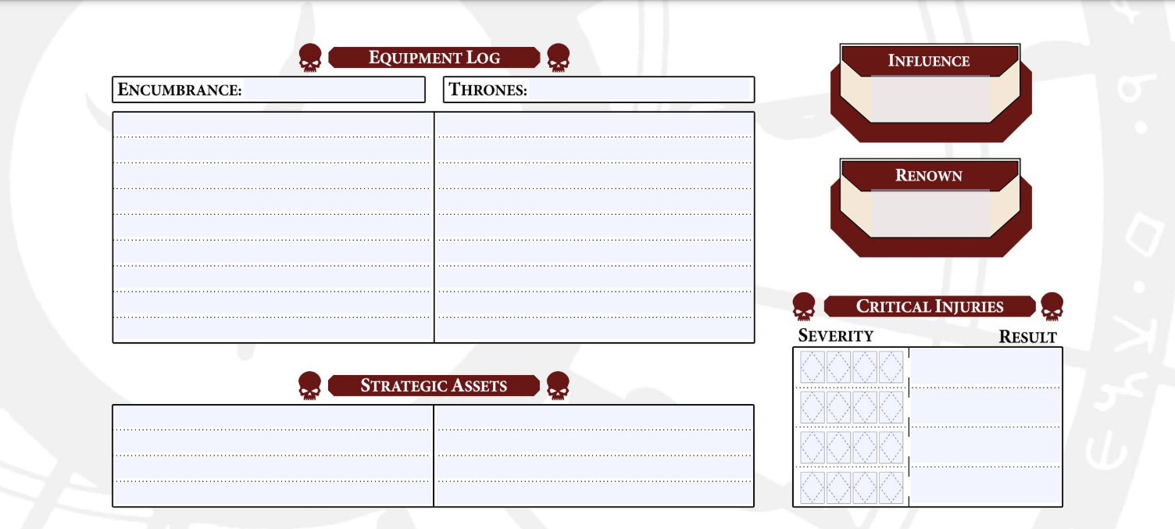
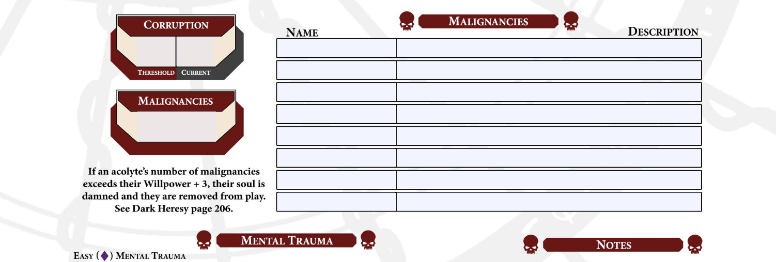
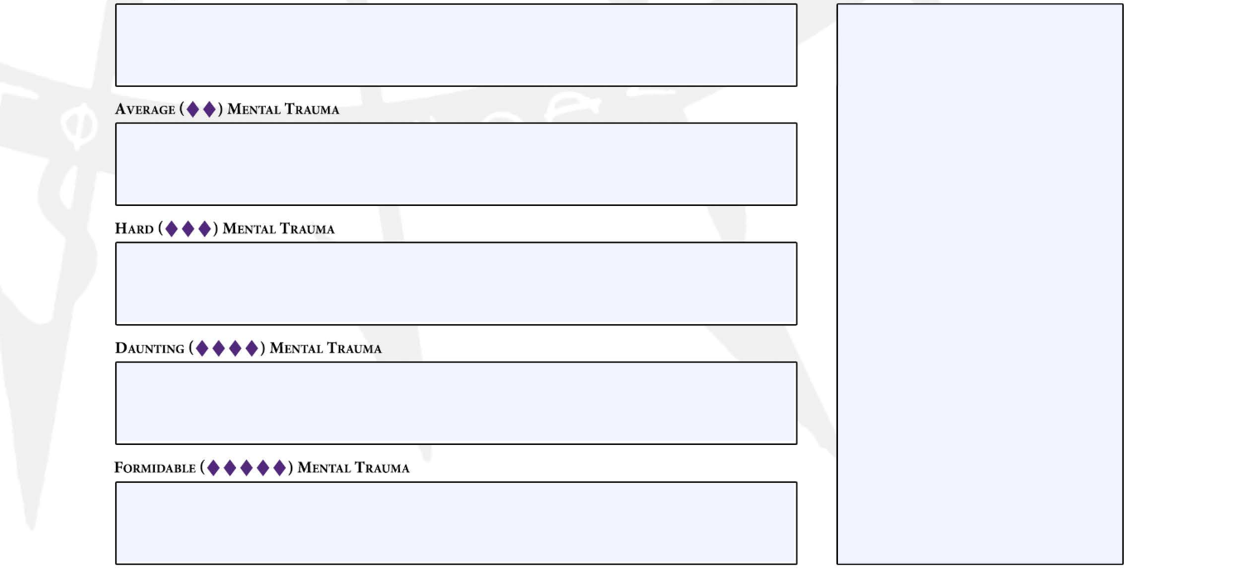
7-19/19
127
6
Manacles
Traveller’s Duffle
Spider-Butt Brain
List of wants:
Superior Armor Customization -1 Enc +1 Soak - 5,000
Military Power Supply - 5 day power supply - 3,000
9
13
3
At Home in Armour: Feudal Worlders reduce the encumbrance of worn armour by 2, to a minimum of 0.

Slide 3
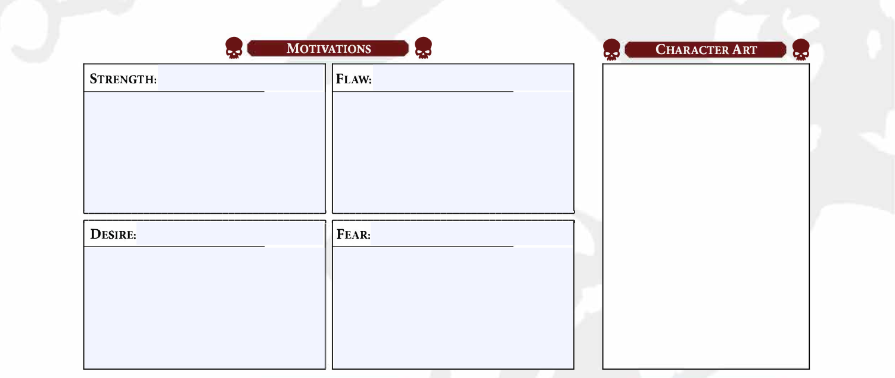
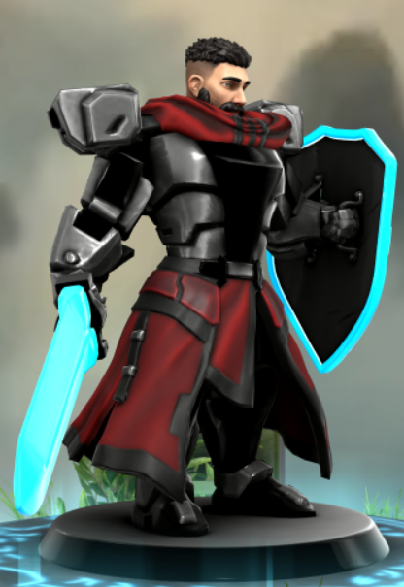
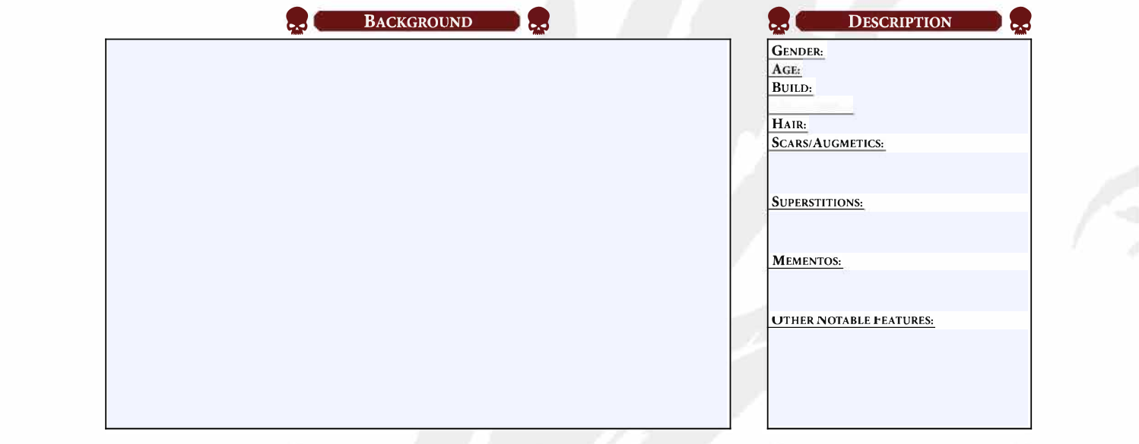
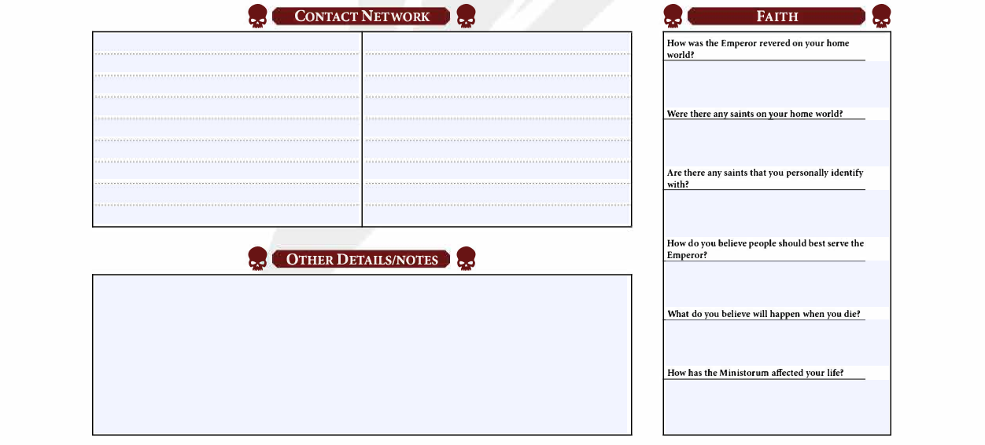
Courageous
Ignorance
Gerhart throws himself into combat situations as he knows that fighting is the only way he knows to protect those around him alive.
Gerhart does not well understand basic human interaction. He is often brusque and could be considered rude because of it.
Expertise
Failure
Gerhart was overlooked as a prospective Astartes, to prove his value he wants to essentially become a god of warfare.
Gerhart is terrified of losing in combat situations and of losing comrades in combat.
Gerhart was born to Bendran and Hilda Varkuul. His father was an engineer who worked on aqueducts. His mother was a herbalist.
He always dreamt of becoming an Astartes, a space marine. He squired under a local veteran soldier, Kell, who retired here for a peaceful end of life. Kell trained him and prepared him for when the Imperium would arrive to select their Astartes conscripts. He was passed over. Instead, his mentor guided him towards service as an acolyte to an Inquisitor, even going so far as to give him his armor and weapons.
He is prepared to do his duty and prove his worth to the Imperium in his new role as Acolyte.
Male
19
6’3”, broad, muscular
Near black hair brown eyes
No scars,yet.
He has an old garlic-shaped pendant. He believes that if he doesn’t wear it, then orcs will catch his scent and try to eat him.
His pendant, weapons, and armor.
The absolute authority, those who question him are burnt at the stake.
None.
Marcus Achallor
Synthmuscle - +1 Brawn
Subskin Armor - +1 Soak
Follow blindly, we are not to question, we are to prove our worth.
I will be given new life and greater power if I die in service to the emperor.

Slide 4
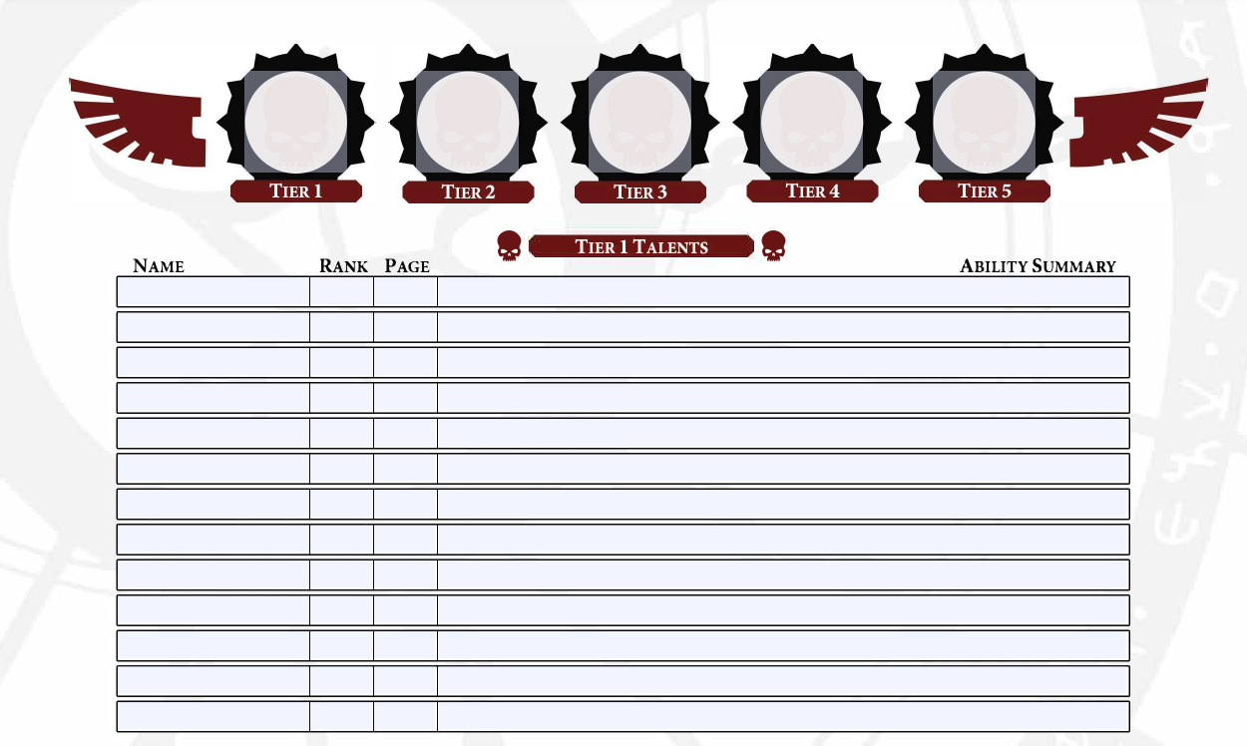
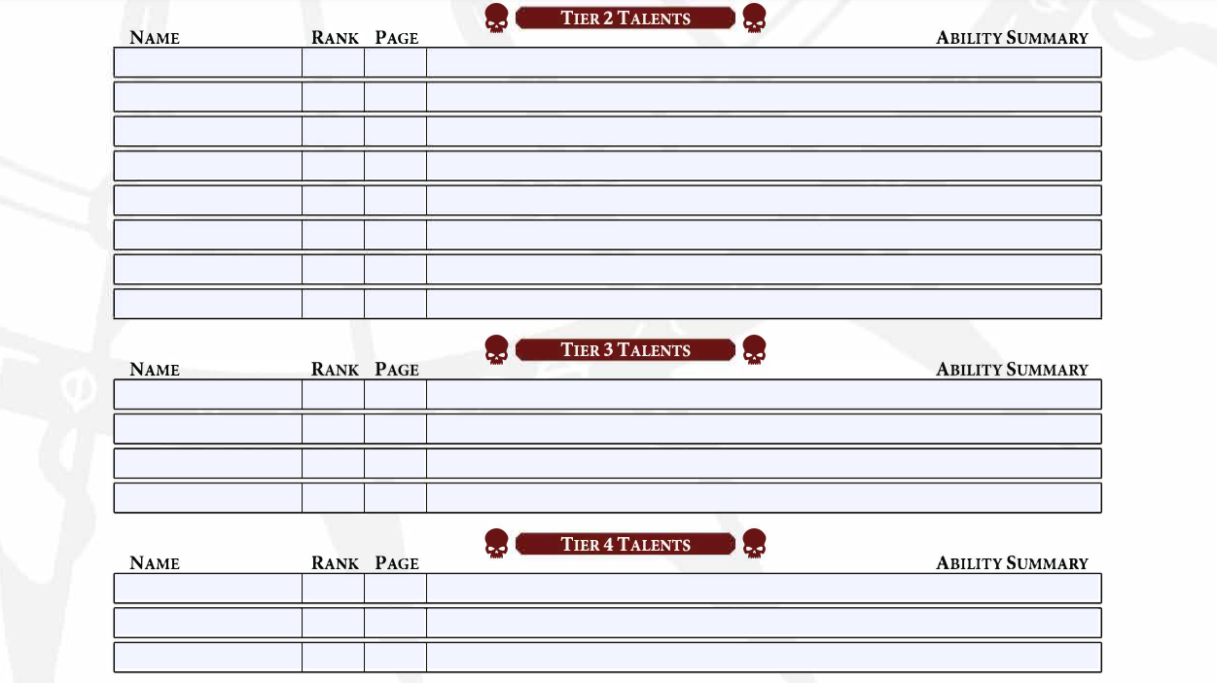
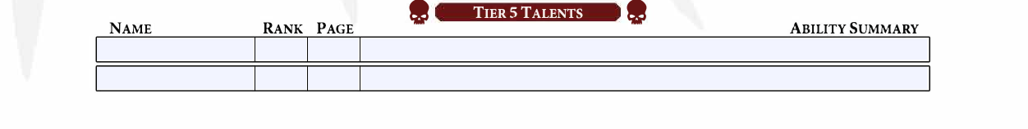
9
8
7
4
3
Durable
1
73
Reduces any Critical Injury result they suffer by 10 per rank of Durable, to a minimum of 01.
Parry
5
74
After damage before soak, suffer 2 strain to use this talent to reduce the damage of the hit by two plus their ranks in Parry
Toughened
3
Each rank of Toughened increases your character’s wound threshold by two.
Well Organized
2
Your character increases their encumbrance threshold by two per rank of Well Organized.
Crack Shot
No
Your character removes a single Black die added to their combat checks due to use of the Aim maneuver.
Second Wind
3
Once per encounter, your character may use this talent to heal an amount of strain equal to their ranks in Second Wind.
Quick Draw
1
Once per round on your turn, use this talent to draw or holster an easily accessible weapon or item as an incidental. Quick Draw also reduces a weapon’s Prepare rating by one, to a minimum of one. You should use this talent in all settings.
Desperate Recovery
No
Heal an additional 2 strain at the end of an encounter if strain is at over ½ of threshold.
Grit
4
Increases Strain Threshold by 1 per level
Bulwark
No
61
Use Parry for an ally.
Block
No
Allows for use of the “Parry” skill to be used on ranged attacks
Parry
5
After damage before soak, suffer 2 strain to use this talent to reduce the damage of the hit by two plus their ranks in Parry
Toughened
3
Each rank of Toughened increases your character’s wound threshold by two.
Second Wind
3
Once per encounter, your character may use this talent to heal an amount of strain equal to their ranks in Second Wind.
Well organized
2
Your character increases their encumbrance threshold by two per rank of Well Organized.
When your character inflicts a Critical Injury with a melee weapon, you may use this talent to immobilize the target (in addition to the other effects of the Critical Injury). This effect lasts until the end of the target’s next turn.
Grit
4
Increases Strain Threshold by 1 per level
Impaling Strike
No
Dual Strike
No
When resolving a combined check to attack with two weapons in melee combat, your character may suffer 2 strain to use this talent to hit with the secondary weapon (instead of spending Advantage).
Parry
5
After damage before soak, suffer 2 strain to use this talent to reduce the damage of the hit by two plus their ranks in Parry
Toughened
3
Each rank of Toughened increases your character’s wound threshold by two.
Second Wind
3
Once per encounter, your character may use this talent to heal an amount of strain equal to their ranks in Second Wind.
Enduring
5
Increases soak by 1
Parry
5
After damage before soak, suffer 2 strain to use this talent to reduce the damage of the hit by two plus their ranks in Parry
Grit
4
Increases Strain Threshold by 1 per level
Parry
5
After damage before soak, suffer 2 strain to use this talent to reduce the damage of the hit by two plus their ranks in Parry
Enduring
5
Increases soak by 1

Slide 5
9
8
7
4
3
Your character must have purchased the Parry talent to benefit from this talent. When your character suffers a hit from a melee combat check and uses Parry to reduce the damage from that hit, after the attack is resolved, you may spend Despair or threat from the attacker’s check to use this talent. Then, your character automatically hits the attacker once with a Brawl or Melee weapon your character is wielding. The hit deals the weapon base damage, plus any damage from applicable talents or abilities. Your character can’t use this talent if the original attack incapacitates them. You should use this talent in all settings.
While armed with a Melee (Light) weapon, your character may use this talent to make an Average Melee (Light) check. If successful, your character may force one engaged target to either drop one weapon they are holding or move up to one range band in a direction of your choosing, as long as this move is possible. If your character forces a named rival or nemesis into dangerous terrain (or off a ledge or cliff) using this talent, your GM can spend a Story Point to allow them to catch themselves at the edge and fall prone instead.
Grit
4
Increases Strain Threshold by 1 per level
Martial Weapon Master
No
Improved Parry
No
Defensive
1
Each rank of Defensive increases your character’s melee defense and ranged defense by one. You should use this talent in all settings.
Deny The Witch
No
When targeted by the effects of a Psychic Power, you may add one Fail to the pool for each rank your character has in Discipline.
Defensive
2
Each rank of Defensive increases your character’s melee defense and ranged defense by one. You should use this talent in all settings.

